Slide 1

Beyond QWERTY:
Revolutionizing Medical
Insurance Form Filling
with AI-Powered Voice
Recognition
An AI-Intensive Project Transforming Traditional Data Entry
Presented by Rishiraj Yadav, Intern at Infosys AI Springboard, Batch 2

Slide 2

Project Overview: Voice-Based Form Filling
Objective
Problem
ReplaceꢀkeyboardꢀentryꢀwithꢀAI-poweredꢀvoice-to-text.
Manualꢀformsꢀareꢀtedious,ꢀerror-prone,ꢀandꢀinaccessible.
Modernizing Insurance
Transforming Data Entry
Our project aims to revolutionize medical insurance form filling
using cutting-edge AI technology, specifically voice recognition.
We envision a future where forms can be filled accurately and
quickly, simplifying the process for both users and insurance
providers.

Slide 3
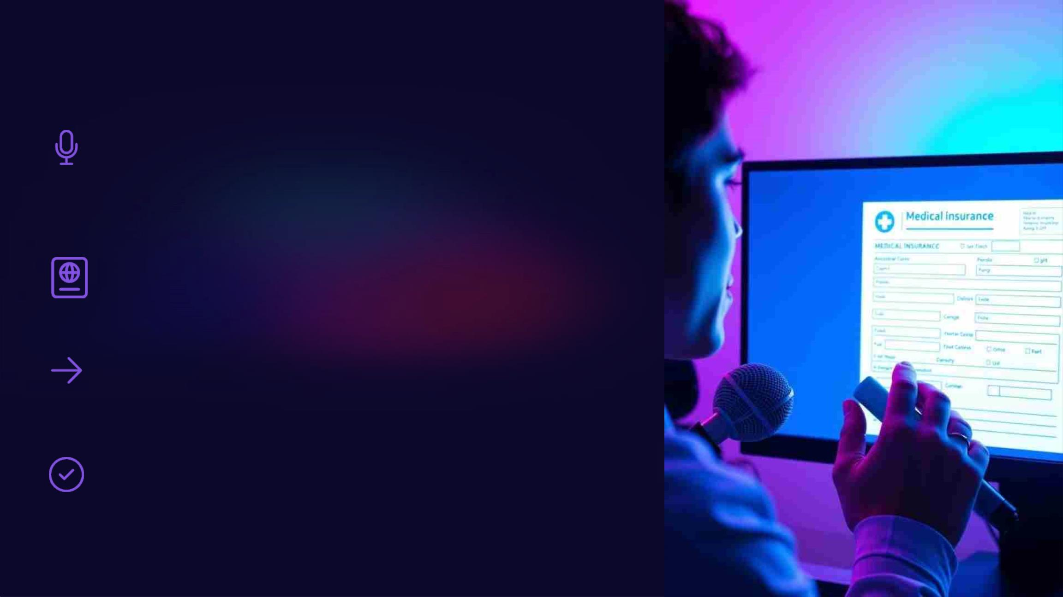
Introducing Voice Recognition
Technology
Speech-to-Text
Our solution utilizes AI-powered voice recognition technology, allowing users to dictate their
information.
PDF Generation
Dynamically creates forms with details.
Automated Data Entry
The system translates spoken words into text, automatically populating form fields.
Accuracy and Efficiency
This streamlines the process, reduces errors, and significantly improves efficiency.

Slide 4

AI-Powered Voice-Based Form Filling: Key Features
Speech Recognition
1
Our system uses the WebkitSpeechRecognition API to process and understand spoken language.
Natural Language Processing
2
It utilizes NLP to interpret the meaning of user's speech, extracting relevant data.
Form Validation
3
The system ensures that the captured data is accurate and adheres to the form's
structure.
PDF Generation
4
The filled form is automatically generated as a PDF, ready for
submission.

Slide 5

Impact on Productivity and
Efficiency
30%
Time Savings
Significantly reduces the time required to complete forms, boosting productivity.
80%
Error Reduction
Minimizes data entry errors, leading to fewer corrections and rework.
95%
User Satisfaction
Enhances user experience by simplifying the process and reducing frustration.

Slide 6
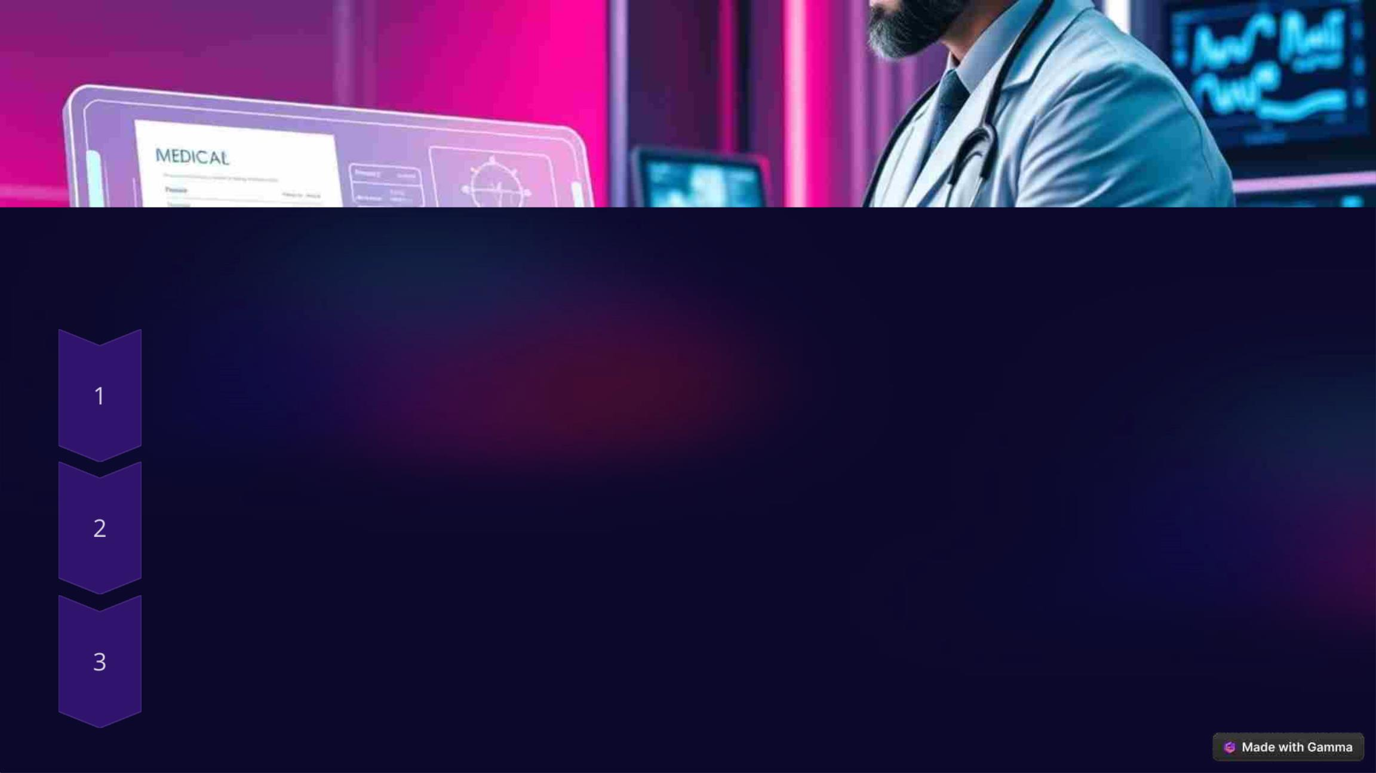
The Future of AI-Driven Medical Insurance
Personalized Forms
AI can personalize forms based on individual user profiles and medical history.
Real-Time Assistance
Users can receive real-time feedback and guidance during form completion.
Advanced Analytics
Insurance companies can leverage data insights from forms to improve decision-making.

Slide 7
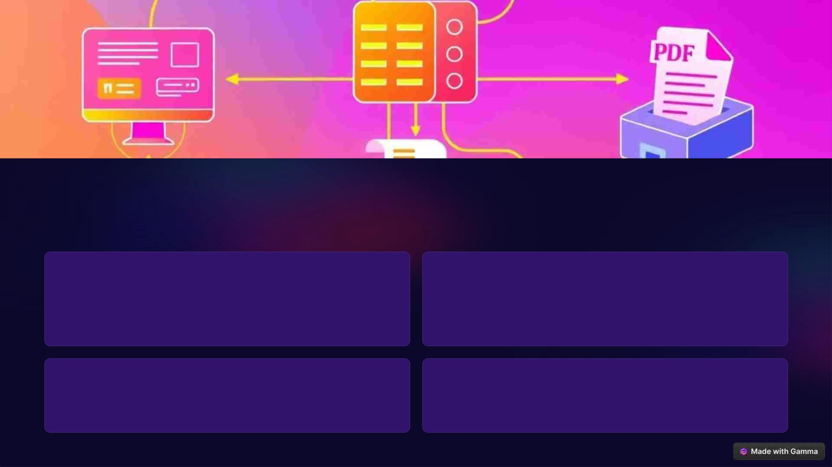
Technical Architecture
Frontend
Backend
HTML, CSS, and JavaScript for a user-friendly interface.
Flask Framework for routing, handling requests, and
processing data.
Database
PDF Generation
MySQL for secure storage of user and form data.
ReportLab library for dynamic PDF creation.

Slide 8

WebkitSpeechRecognition API
Browser-Based
1
Real-time speech-to-text conversion.
Machine Learning
2
Uses NLP techniques to transcribe speech to text.
Benefits
3
High accuracy, easy adaptation, reduces typing errors.

Slide 9
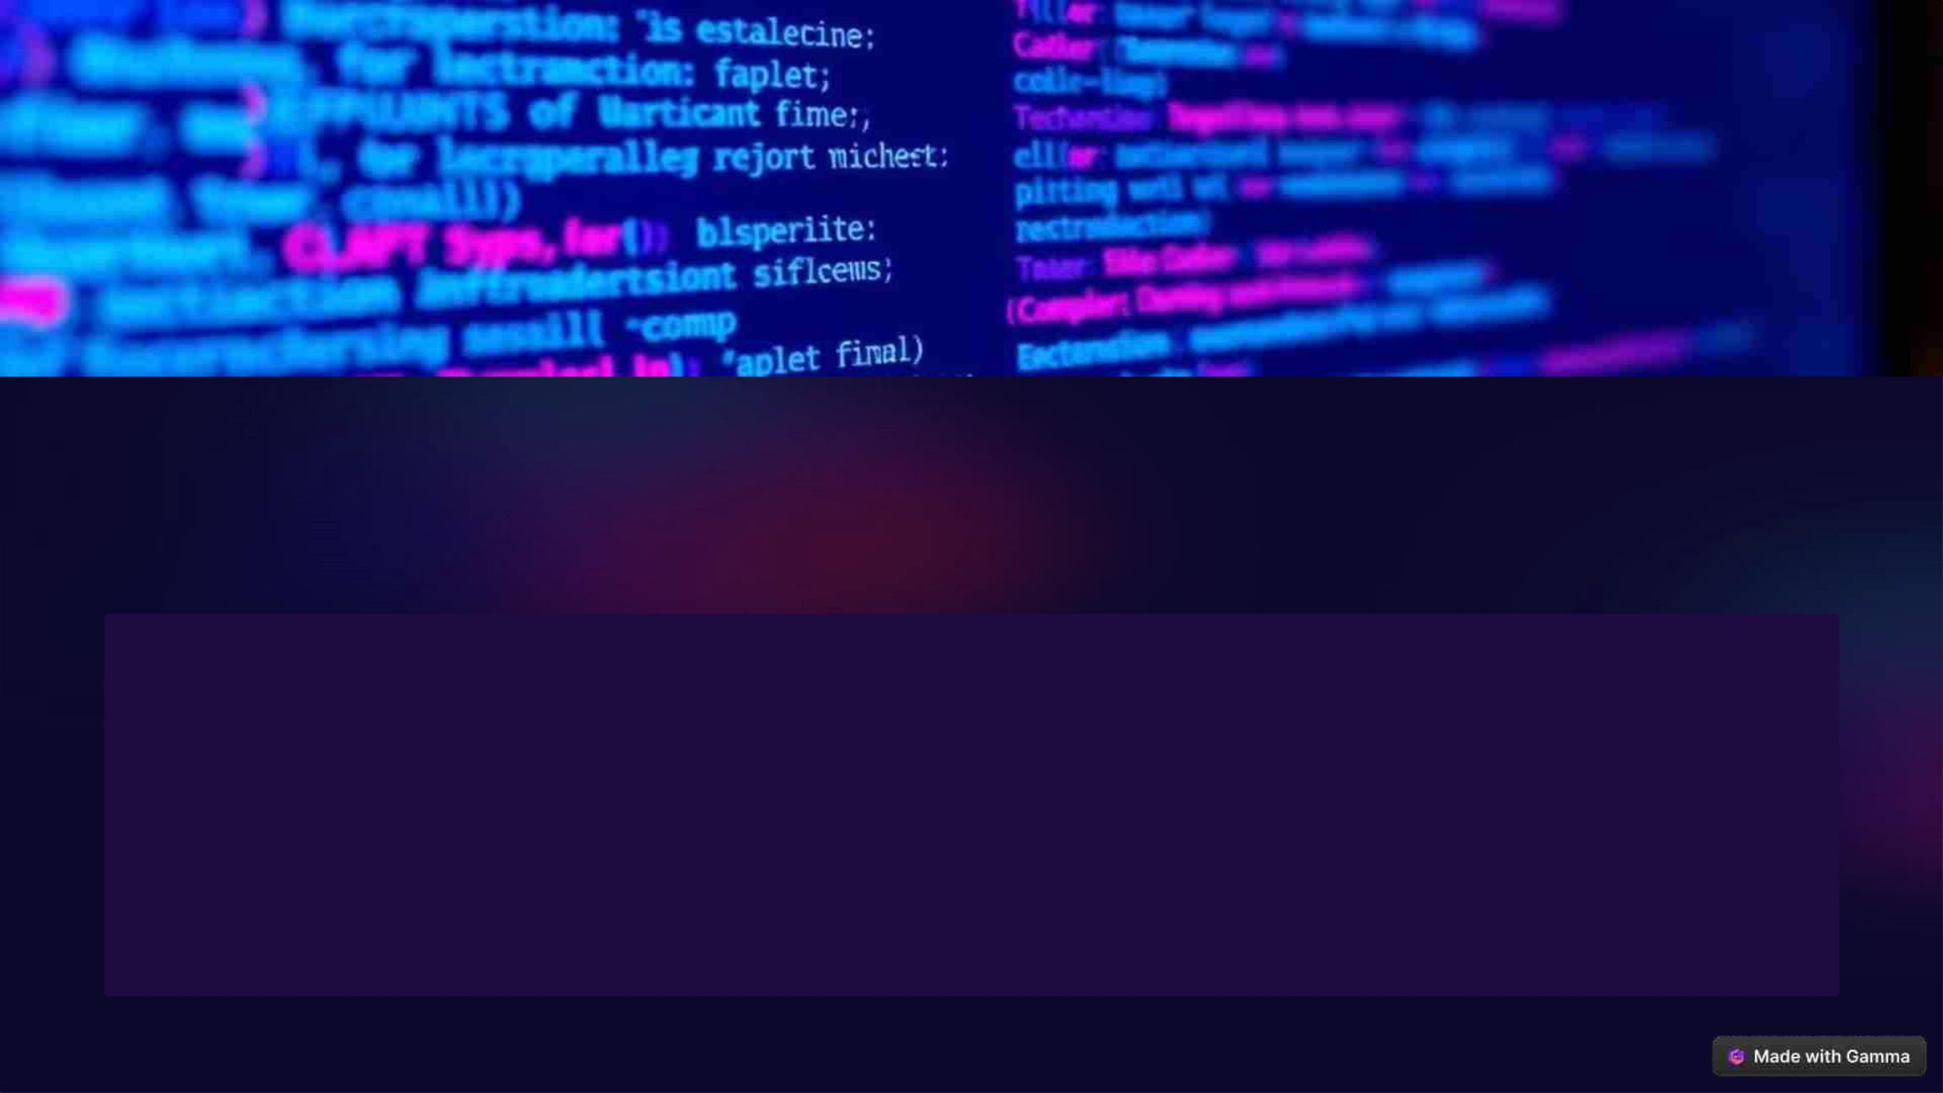
WebkitSpeechRecognition API
const recognition = new WebkitSpeechRecognition();
recognition.lang = 'en-US';
recognition.start();
recognition.onresult = (event) => {
const transcript = event.results[0][0].transcript;
// Process the transcript and populate the form fields.
};

Slide 10

Workflow Structure
User Authentication
1
Users log in to the platform with their credentials or
create an account.
2
3
4
5
Form Navigation
Users select the desired form from a list or by searching
for specific terms.
Voice Input
Users speak their information, which is captured by the
voice recognition engine.
Translation and Validation
The system translates spoken words into text, validating
the data for accuracy.
PDF Generation
A PDF of the filled form is generated and made available
for download or submission.

Slide 11

AI Integration in Detail
Speech Recognition
1
Leveraging NLP to understand and transcribe user inputs.
Multilingual Support
2
3
Powered by Google Translate to ensure inclusivity.
Automation
Voice recognition combined with PDF generation eliminates
manual effort.

Slide 12

Challenges & Solutions
Challenge 1
Handling speech recognition accuracy in noisy environments.
Solution
Implement noise cancellation algorithms.
Challenge 2
Managing multilingual inputs.
Solution
Robust integration with Google Translate API.
Challenge 3
Dynamic PDF creation with complex forms.
Solution
Use ReportLab library for scalable PDF generation.

Slide 13

Accuracy Analysis:
WebkitSpeechRecognition
in Beyond QWERTY
The accuracy of WebkitSpeechRecognition within our Beyond QWERTY
project.

Slide 14
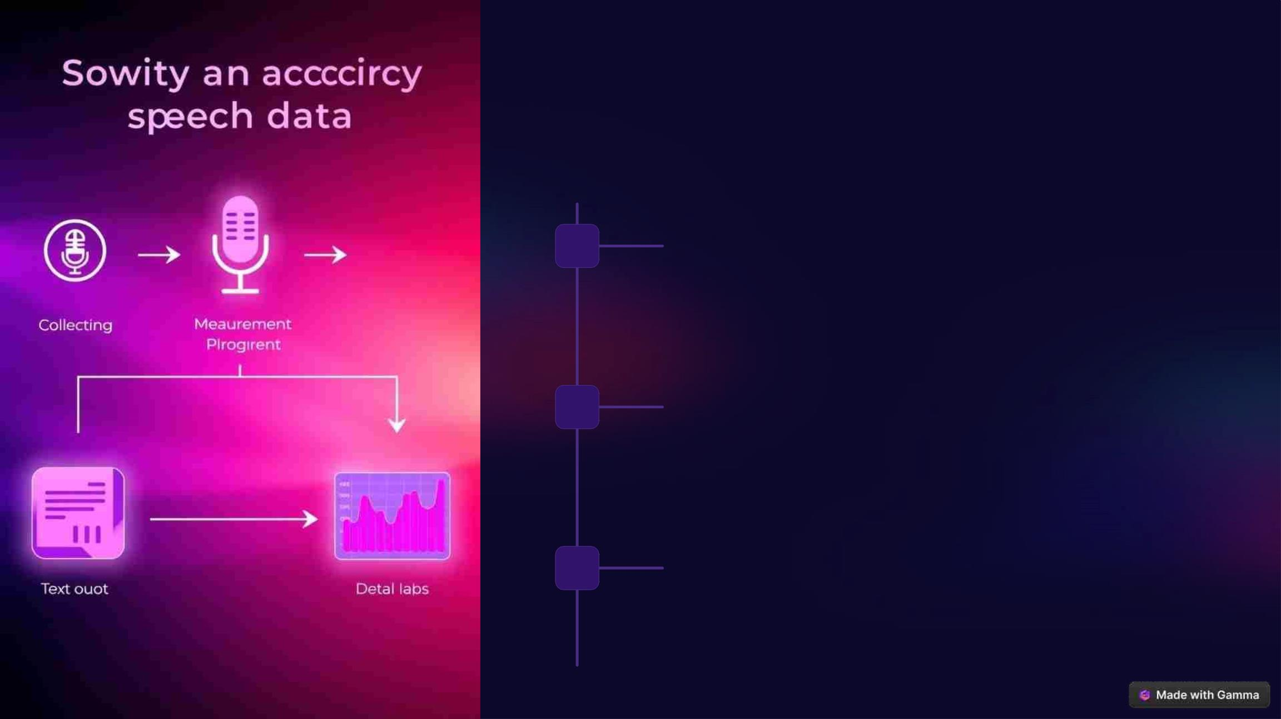
Methodology for Accuracy
Measurement
1
Data Collection
We collected a diverse dataset of speech samples covering
various accents and linguistic styles.
2
3
Recognition Testing
The dataset was fed into the WebkitSpeechRecognition API to
measure the accuracy of transcriptions.
Analysis and Evaluation
We compared the transcribed text to the original speech to
determine the percentage of accurate recognition.

Slide 15
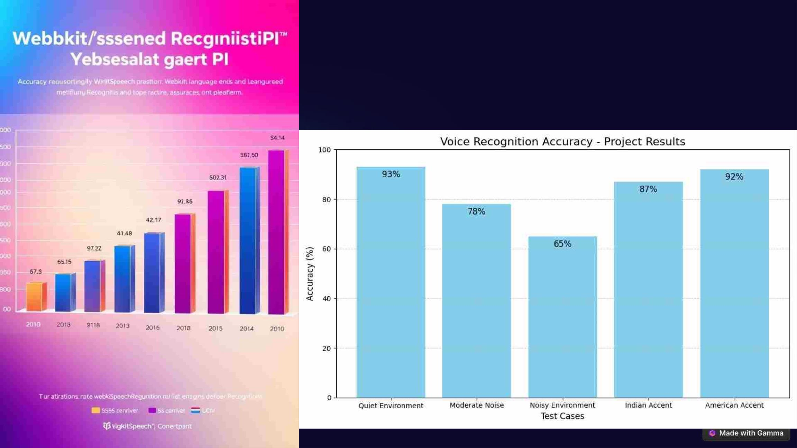
Key Findings: Recognition
Accuracy Rates

Slide 16
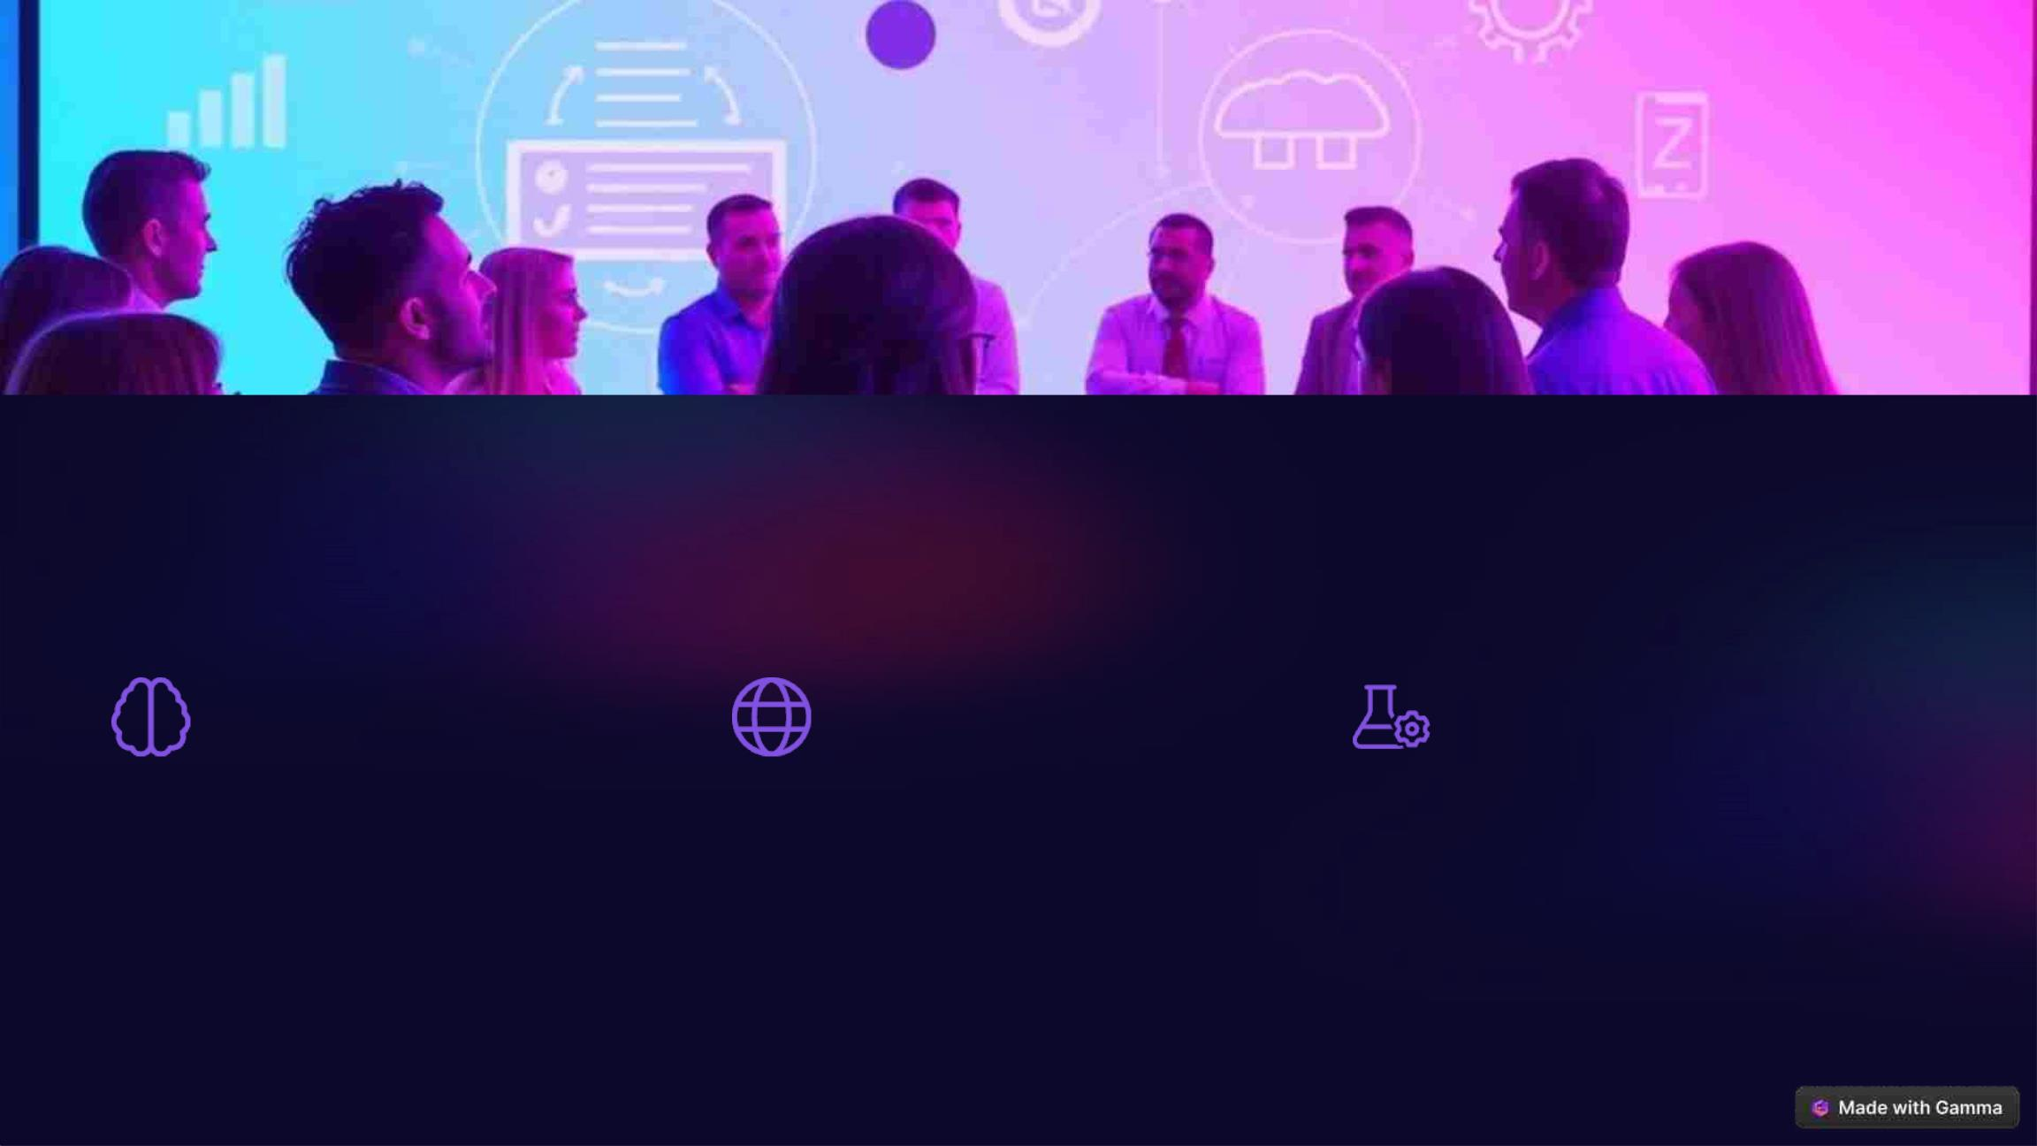
Future Improvements and Next Steps
Adaptive Learning
Multilingual Support
Personalized Settings
Continued development of AI-powered
models to improve recognition accuracy
over time.
Expanding support for a wider range of
languages to cater to diverse user
populations.
Allowing users to adjust settings like
accent and noise cancellation to optimize
accuracy.

Slide 17

Beyond QWERTY in
Action: Project Demo
Real-Time Demo: Voice
Form Filling Process

Slide 18
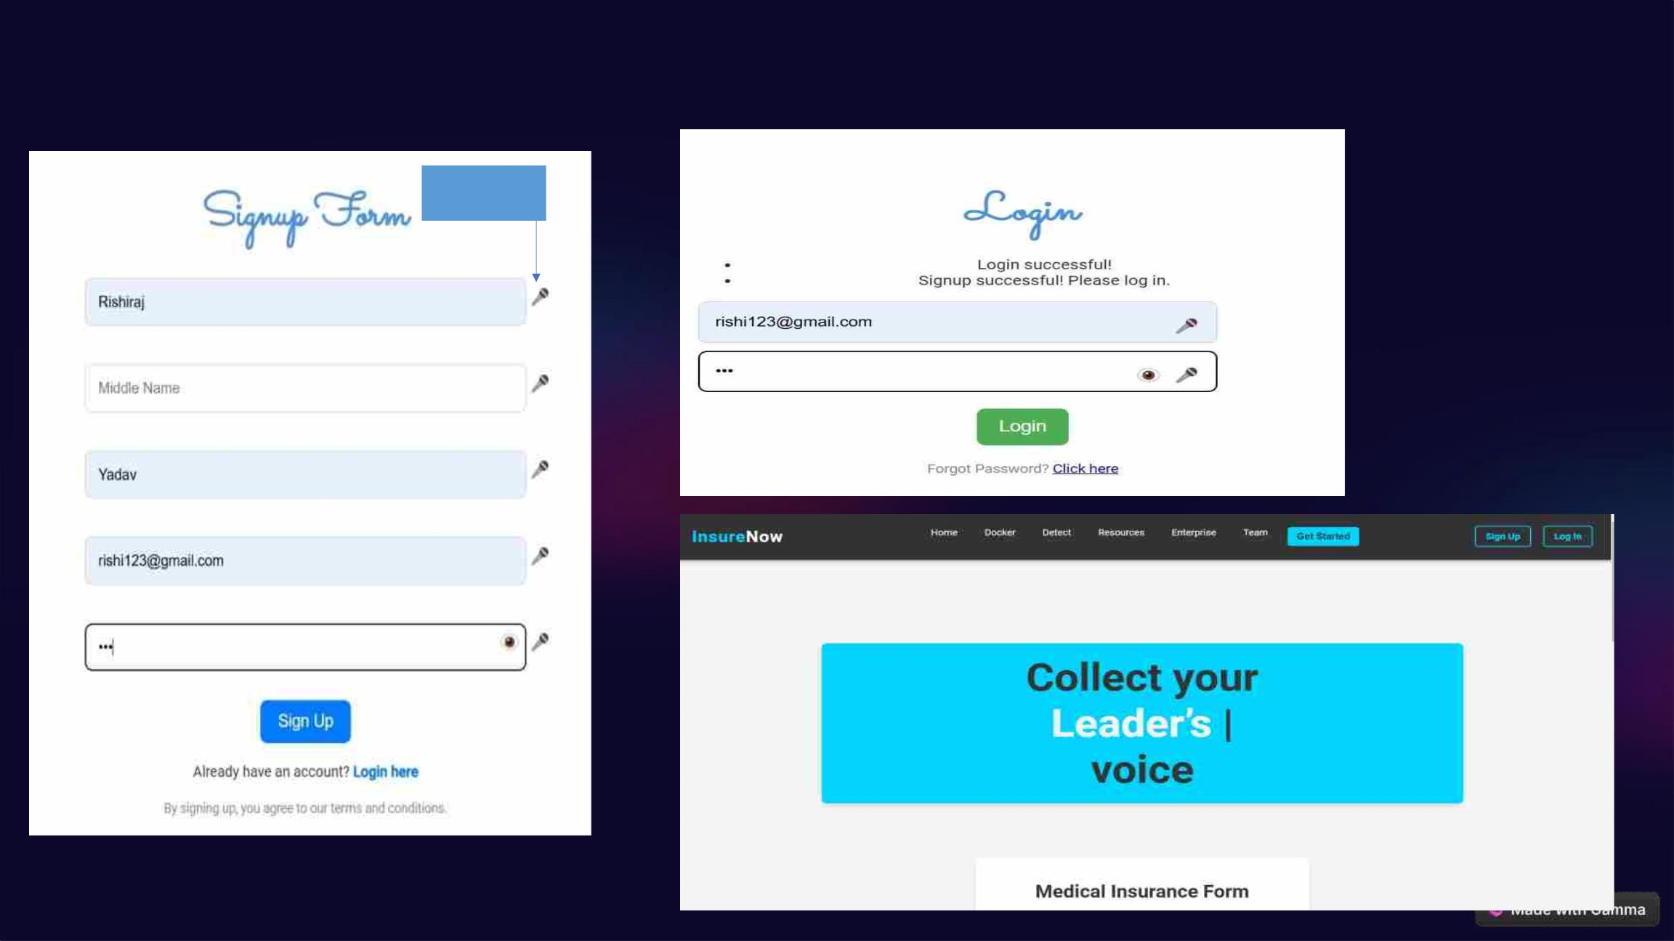
Beyond QWERTY in Action: Project Demo
Click to Open Mic
&
Enter the Input

Slide 19
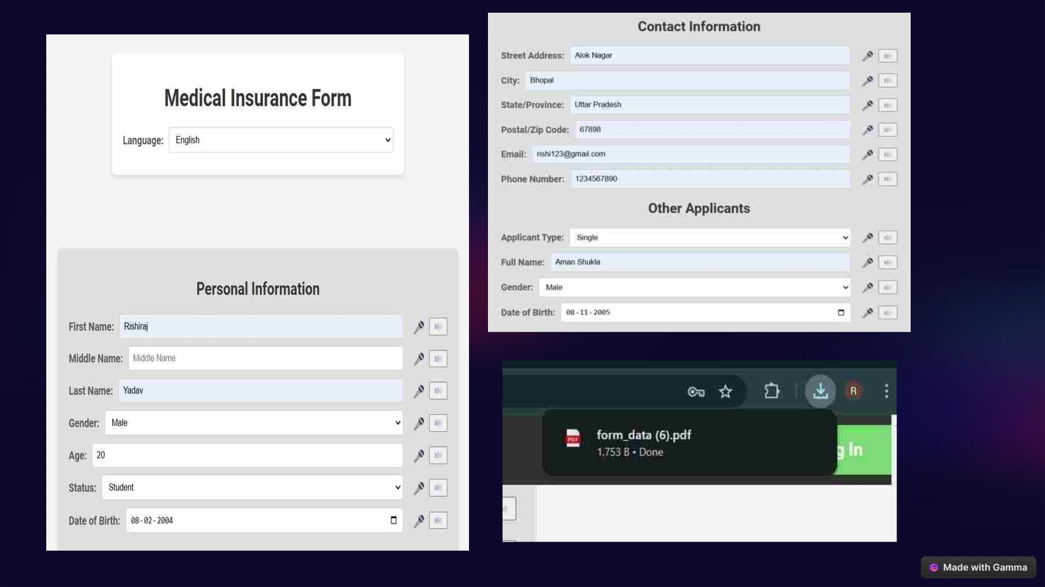

Slide 20
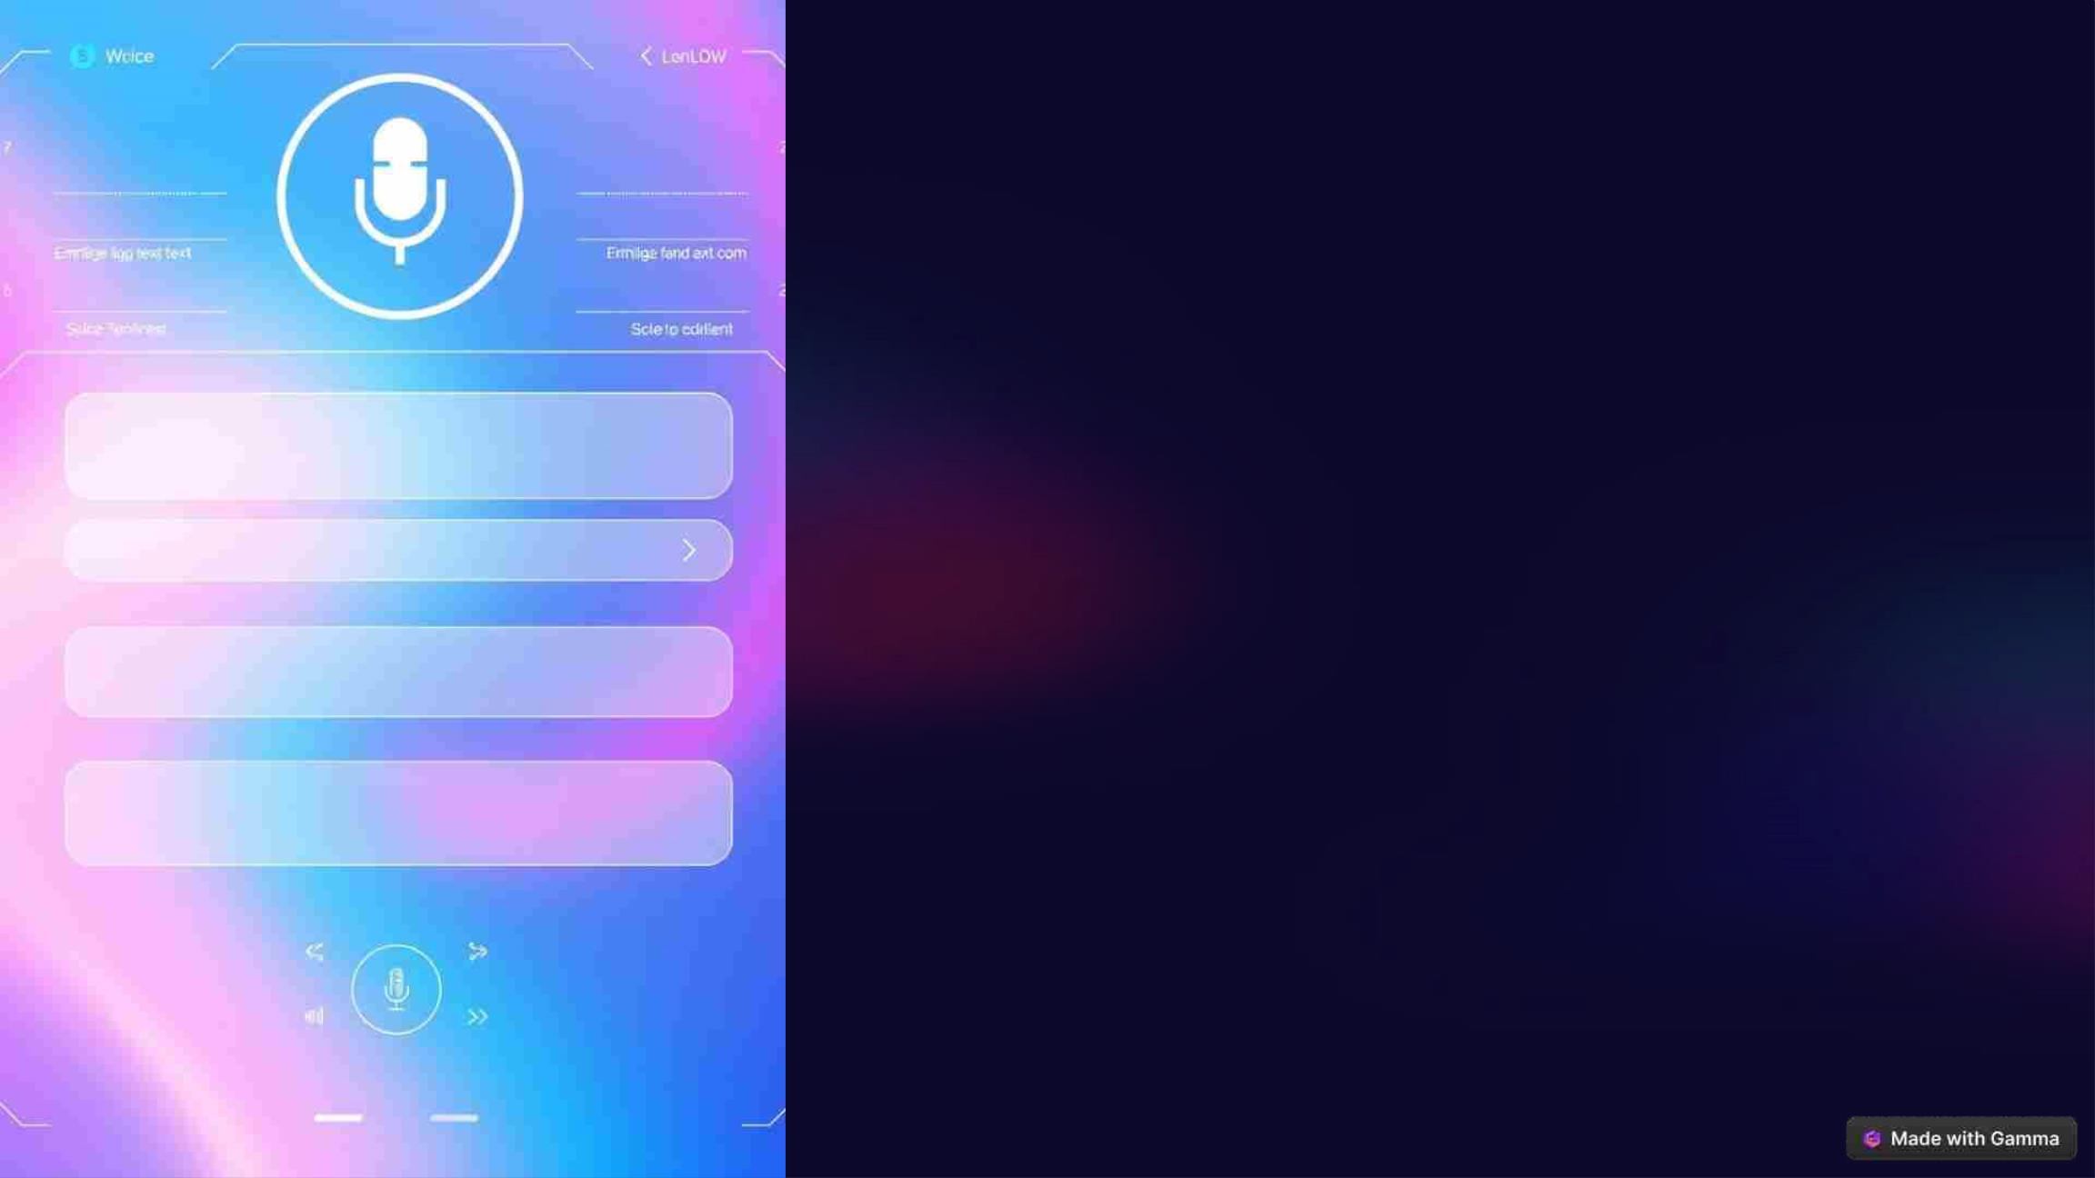
Voice Form Filling:
Revolutionizing Data
Entry
Voice form filling is a groundbreaking technology that streamlines data entry,
enhancing user experience and boosting productivity. This presentation
explores the benefits and real-world applications of this innovative solution.

Slide 21
The Benefits of Voice-Driven Form Filling
Increased Speed and
Efficiency
Enhanced Accessibility
Reduced Errors and
Improved Accuracy
For individuals with disabilities, voice
input can be a game changer, providing
an alternative to traditional keyboard and
mouse interactions, making forms more
accessible and inclusive.
Voice form filling allows users to input
data quickly and effortlessly, eliminating
the need for manual typing and reducing
errors. This translates to significant time
savings and a more efficient workflow.
By minimizing manual data entry, voice
form filling significantly reduces the risk
of typos and mistakes, leading to
improved data quality and reliability.

Slide 22
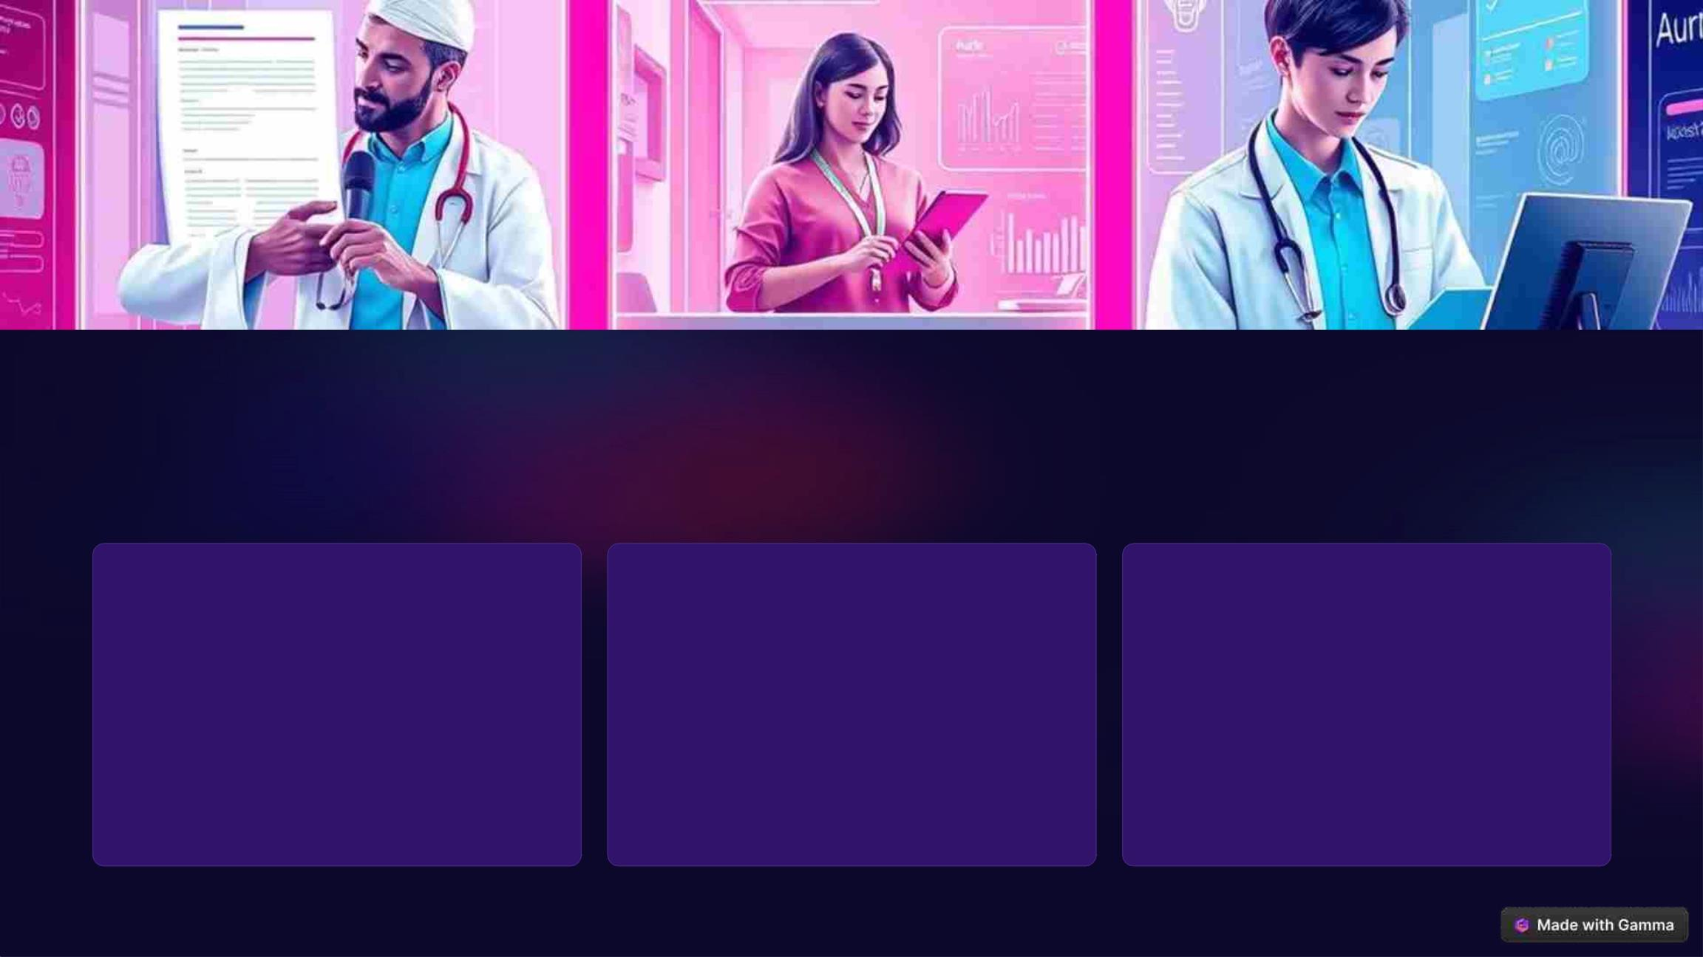
Real-World Use Cases and Applications
Healthcare
Customer Service
Education
Doctors and nurses can use voice
form filling to document patient
information and prescriptions more
efficiently, streamlining patient care.
Customer service representatives can
quickly capture customer details and
requests using voice input, improving
customer satisfaction and resolving
issues faster.
Students can utilize voice form filling
to complete assignments and
surveys, freeing up time for learning
and research.

Slide 23

The Future of Voice-Driven
Form Filling
Voice-driven form filling is poised to transform how we interact with
technology. As voice recognition technology continues to advance, we can
expect to see even more sophisticated and user-friendly voice-driven forms in
various applications, making information gathering more accessible and
efficient.

